Slide 1

Total Quality Management (TQM)
Class Presentation
Topic : FMEA (Failure Mode Effect Analysis)
Sector: Pharmaceuticals
Company: Abbott Laboratories
Presenting By:
Muhammad Hasan Yousfani (20181-24866)
Presenting to: Miss Mehreen kausar azam

Slide 2
“Failure Mode and Effects Analysis”
FMEA
What is FMEA?
Failure Mode and Effects Analysis (FMEA) is a structured way to identify and address potential problems, or failures and their resulting effects on the system or process before an adverse event occurs.
First Time used in 1949 and 1960 by NASA.
Quality Tool?
Yes, It is the technique par excellence of quality tools. They are the abbreviations of Failure mode and effects analysis (FMEA). FMEA is based on the application of a procedure for classifying potential failures based on their severity, frequency and detection capacity.

Slide 3
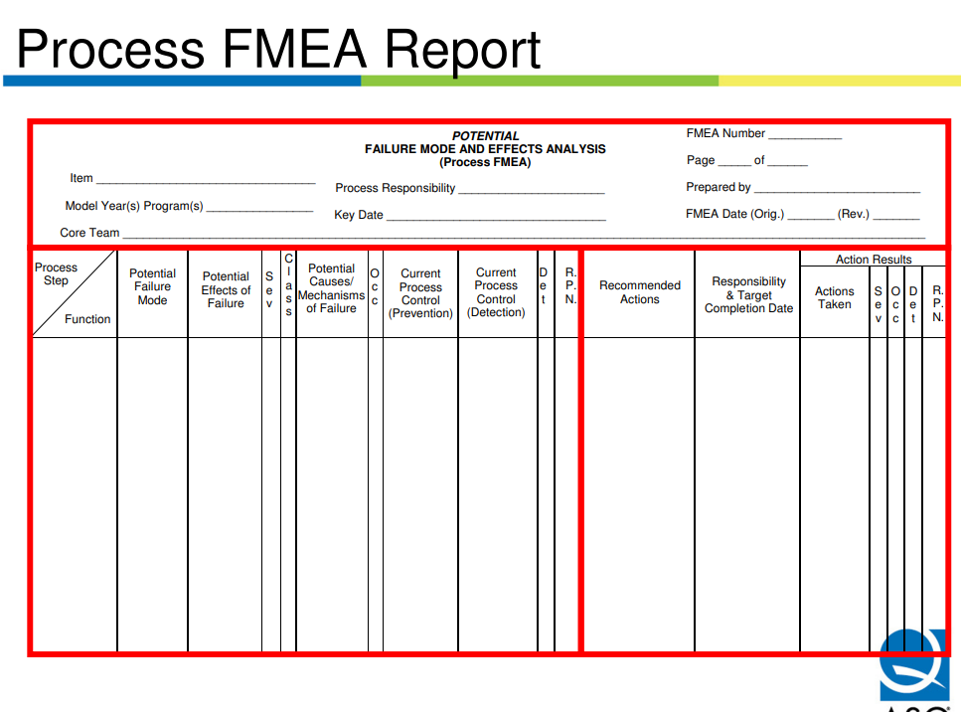

Slide 4
Process FMEA Analysis
Process Step:
    Process Step is simply the focus of the analysis
Function:
    Describe the function or requirement to be analyzed
Potential Failure :
    Describe how the item could potentially fail to perform its function
Potential Effects OF Failure:
    State the effects of the failure in terms of the specific system, subsystem, or component being analyzed
Potential causes/ Mechanism of failure:

Slide 5
Process FMEA Analysis
Potential causes/ Mechanism of failure:
    Identify potential causes of the item not performing its intended function
Current Process Control (Prevention):
    This column is reserved for the methods that have been used to prevent a specific cause
Current Process Control( Detection):
    This column is used to document methods that have been used to detect either the cause or the failure mode.
Severity:
    Severity evaluates the impact of the effect

Slide 6
Process FMEA Analysis
Occurrence:
    Occurrence rates how often a specific cause is likely to result in the failure mode being analyzed.
Detection:
    Detection ranks our ability to detect either a cause or a resulting failure mode. Use best detection available.
Risk Priority Number(RPN):
    Risk Priority Number is the product of the severity, occurrence, and detection rankings.

Slide 7
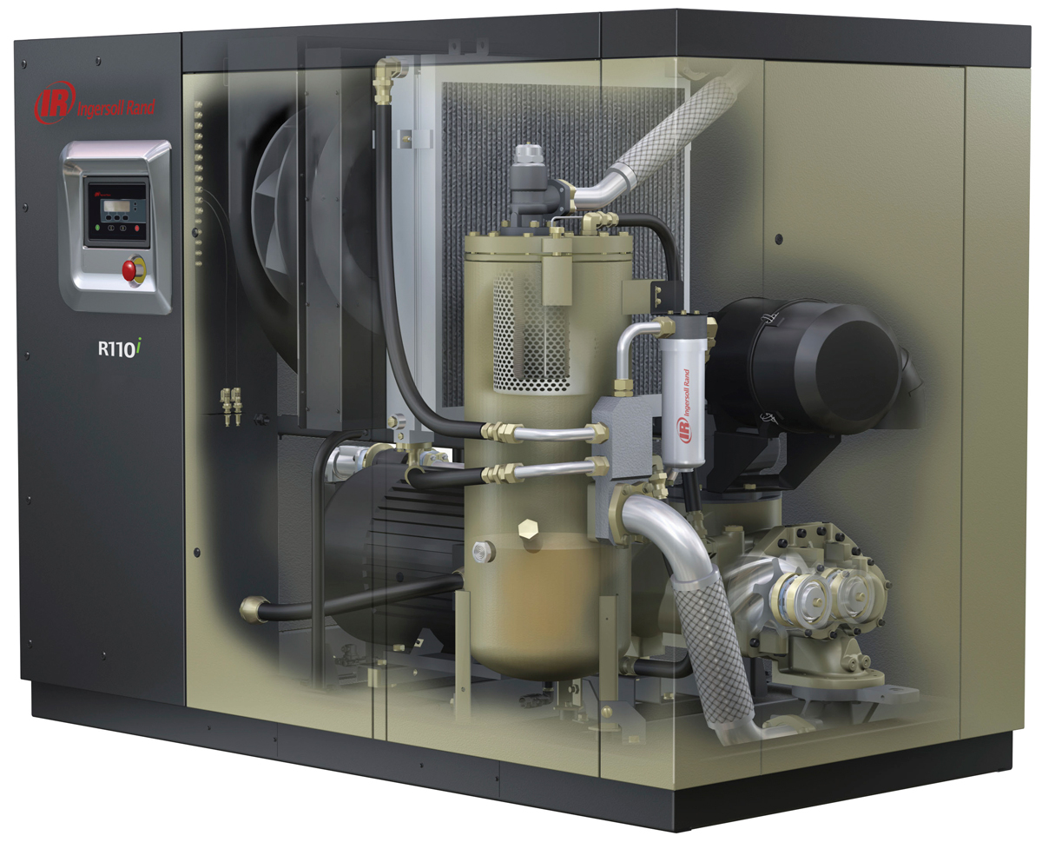
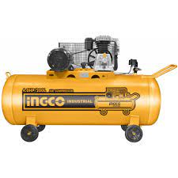
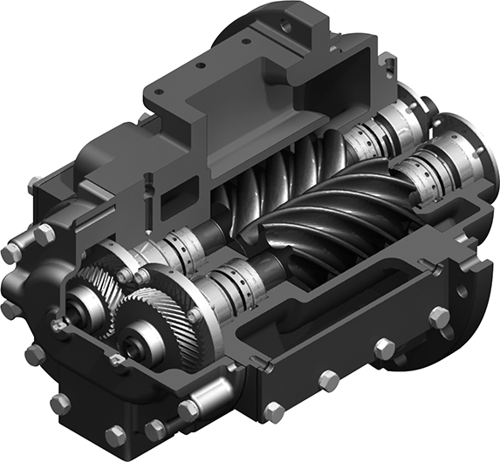
Air Compressor
An Air Compressor is an equipment used to generate compressed
air for industrial use.
Rotary Screw Air Compressors
A Rotary-Screw Compressor use two very closely meshing helical screws, known as rotors, to compress the gas. In a dry-running rotary-screw compressor, timing gears ensure that the male and female rotors maintain precise alignment without contact which would produce rapid wear.
Types of Rotary Screw Air Compressors
Oil-Injected
Oil-Free

Slide 8
FMEA (Failure Mode Effect Analysis)
Air Compressor
Item | Potential Failure Mode | Potential Effect of Failure | Severity | Potential Cause | Current Condition | Occurrence | Current Design Control Document | Detection | Recommended Action | Responsibility | Action Taken | S | O | D | RPN
Oil Free Air Compressor | Short Circuit | Malfunction | 9 | Improper connections | All Connection Satisfactorily checked | 2 | Commissioning checklist to be ensured from vendor & custodian | 5 | FAT & SAT Visit before commissioning | Custodian | Megger Test, Thermography | 9 | 2 | 5 | 90
 | Oil traces in Compressed air | Oil leakage inside compression chamber | 7 | Oil Seal Leakage | Inspection for oil traces in compressed air | 2 | Drager Tube Test Methodology | 5 | FAT & SAT Visit before commissioning | Custodian | Oil Pressure & Air Filter Status Checks | 7 | 2 | 5 | 70
 | Frequent High Temperature alarm | Tripping | 6 | Overdue Maintenance | Equipment duly maintained | 6 | Maintenance Checklist, Maintenance Master Plan | 2 | Frequent Maintenance checks as per Maintenance Master Plan | Maintenance personnel | Daily Operation Log Review | 6 | 6 | 2 | 72

Slide 9
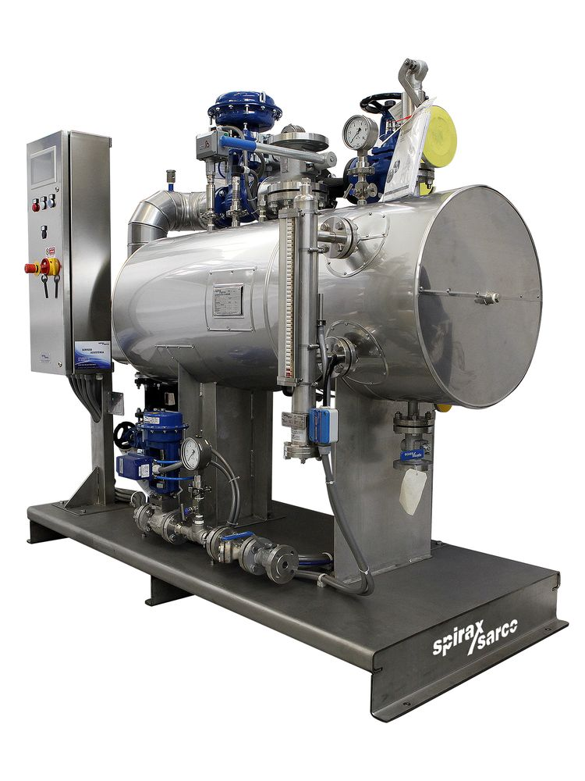
Clean Steam Generator
A Clean Steam Generator is used to generate pure saturated steam from De-Ionized Water for industrial use.
Clean Steam Uses
Clean steam (Pure Steam) is used mostly in the Pharmaceutical industry for the following uses:
For manufacturing various types of drugs and injectable
For use in Autoclaves (sterilization Purpose)
For Drying purpose via Super Heated Steam

Slide 10
FMEA (Failure Mode Effect Analysis)
Clean Steam Generator
Item | Potential Failure Mode | Potential Effect of Failure | Severity | Potential Cause | Current Condition | Occurrence | Current Design Control Document | Detection | Recommended Action | Responsibility | Action Taken | S | O | D | RPN
Clean Steam Generator | Motorized Valve Failure | Inoperative Valve | 9 | Programming Failure | Supply Connected | 2 | Commissioning checklist to be ensured from vendor & custodian | 3 | FAT & SAT Visit before Commissioning | Custodian | Additional budget for training | 9 | 2 | 3 | 54
 |  | Broken Valve Seat | 8 | Line Hammering | Line Connected | 4 | Commissioning checklist to be ensured from vendor & custodian | 3 | FAT & SAT Visit before Commissioning | Custodian | Additional budget for training | 8 | 4 | 3 | 96
 |  | Motor Failure | 5 | Winding Failure | Motor in Working Condition | 4 | Maintenance Checklist, Maintenance Master Plan | 3 | Frequent Maintenance checks as per Maintenance Master Plan | Maintenance personnel | hiring new maintenance personals | 5 | 4 | 3 | 60
 | DI Water Feed Pump Failure | No Clean Steam Generation | 9 | Broken Impeller | Impeller Intact | 2 | DI Water Feed Pump Maintenance Checklist, Maintenance Master Plan | 2 | Frequent Maintenance checks as per Maintenance Master Plan | Maintenance personnel | hiring new maintenance personals | 9 | 2 | 2 | 36

Slide 11
Thank You!

